Slide 1
Introduction to ML

Slide 2
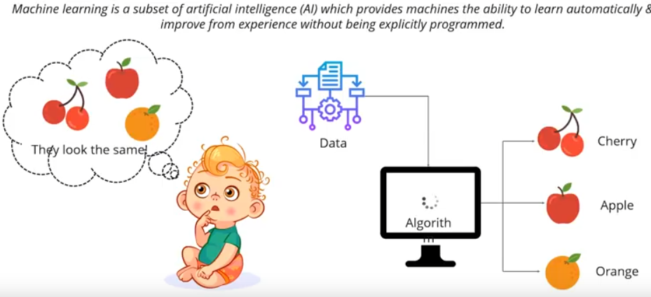
How ML is different from traditional programming

Slide 3
ML in FinTech – My few takes on this
99% of the economic value addition is coming from functional mapping (supervised)
AI/ML will be an important technology for both top and bottom lines
Most of the companies will adopt AI/ML to certain extent for bottom lines
Long term differentiation will come from use of AI/ML for top lines
Data will be the most valuable commodity
Strategic merger/acquisition over data
Companies with no use AI/ML for analyzing customer behavior/pattern will be extinct within next 20 years

Slide 4
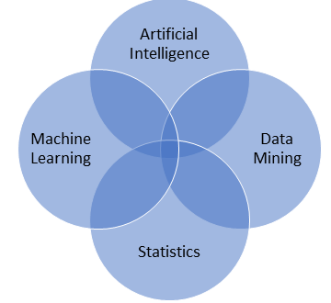
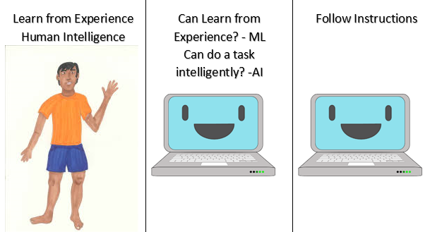
ML proximity with other fields

Slide 5
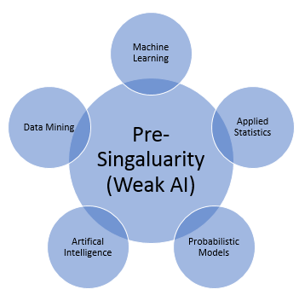

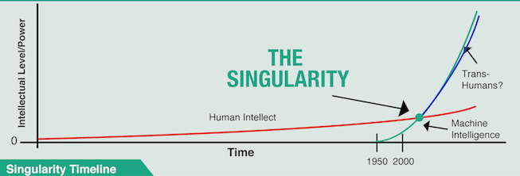
Will artificial big bang happen?
Salesforce Einstein

Slide 6

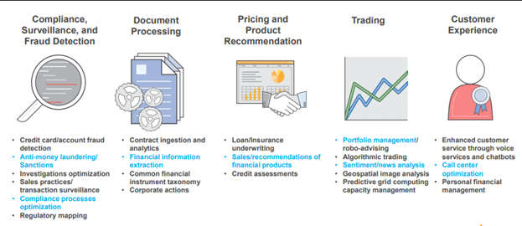
AI in financial service industry

Slide 7

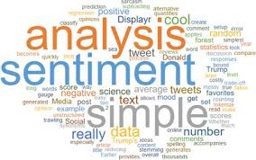


Application – Customer focused

Slide 8




Application – Product focused

Slide 9
Why software engineer should learn machine learning
Reduce programming time
Customize and scale product
Open a possibility of solving new kind of task

Slide 10
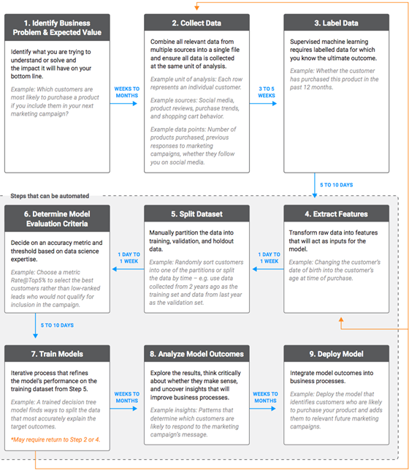
A typical AI/ML project development lifecycle

Slide 11
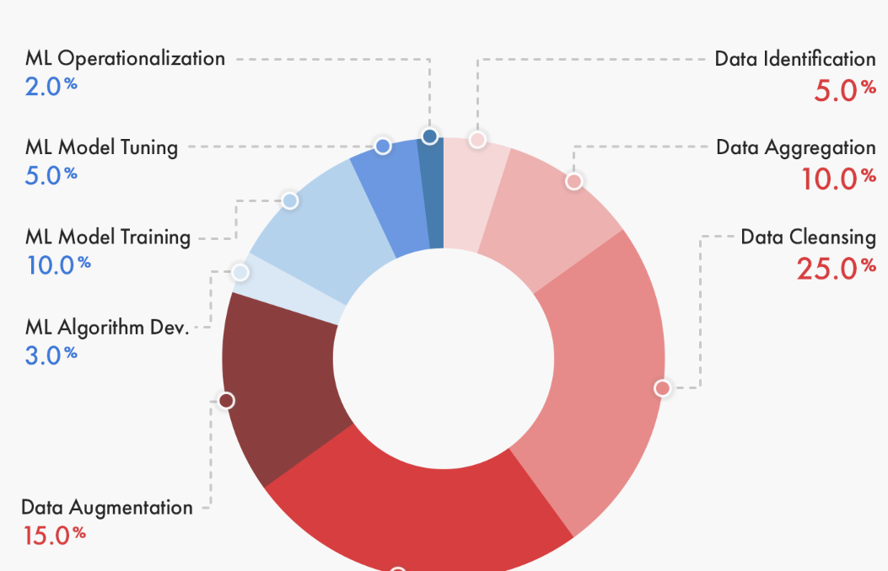
Percentage time allocation for various tasks

Slide 12
How is quality measured in data labelling
Gold standard
There is a correct answer for the task
Sample review
Select a random sample of completed task. An experienced person reviews sample for accuracy
Consensus
Assign several people do the same task, and the correct answer is from the majority
Intersection over union (IoU)
Consensus model often used in object detection within image
Combines people and automation to compare the bounding boxes of your hand labeled, ground truth images with the predicted bounding boxes from the model

Slide 13
Data preparation
Data cleaning
Missing values
Outliers
Sparse class grouping
Duplicates dropping
Data transformation
Categorical encoding
Skewed data
Bias migration
Scaling
Rank transformation
Power functions
Feature engineering
Feature extraction
Capturing feature relationship

Slide 14
Missing values
Deletion
Mean imputation
Substitution
Hot deck imputation
Cold deck imputation
Regression imputation
Stochastic regression imputation

Slide 15
Outliers
Outliers does not necessarily mean noise
In some applications outliers or rare events are the most interesting
Credit card fraud detection
Point outliers
Single data points lay far from the rest of the distribution
Contextual outliers
E.g background noise in the speech signal
Collective outliers
Signal that indicate the discovery of new phenomena
Things that help for modelling outliers
Univariate / Multivariate
Parametric / non parametric
Most popular method – Z score, PCA, LMS, proximity based models

Slide 16
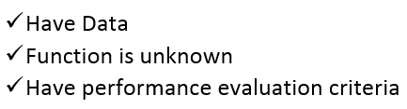
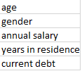
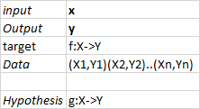
ML Algorithm – A case study
Problem – Credit card approval process
Formalization
So we need a relationship between our data and model
This is done via probability (Maximum Likelihood Estimate)
MLE helps to choose the model with correct parameters
At the heart of any ML problem there lies an optimization problem

Slide 17
Different types of learning
Supervised
Labeled data
Direct feedback
Predict output
Unsupervised
Find hidden structure
No labeled / no feedback
Semi supervised
Small amount of labelled data
Large amount of unlabeled data
Active learning
Algorithm is allowed to query the user for the label of a subset of training instances
Reinforcement learning
An agent learns to achieve a goal in an uncertain environment based on reward

Slide 18
Basic type of machine learning problems
Classification
To classify a output one out of n category
Regression
Predicting a continuous real value
Anomaly detection
Identify if the given input is an anomaly
Clustering
Discover structure in the data
Sequencing problem
Sequence prediction, classification, seq generation, seq to seq prediction
There are other hybrid type of problems
Recommendation, Association

Slide 19
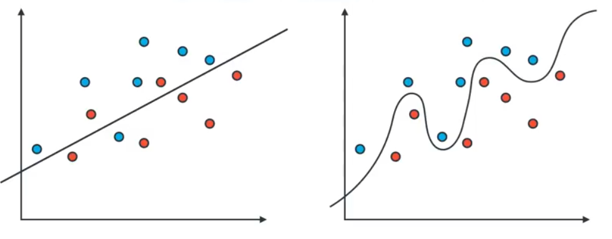
Testing ML models
How well is my model doing?
How do I improve it?
Which model is better

Slide 20
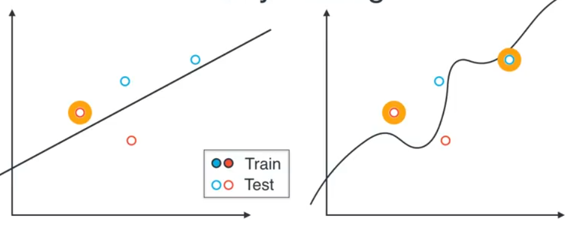
Wait till testing

Slide 21
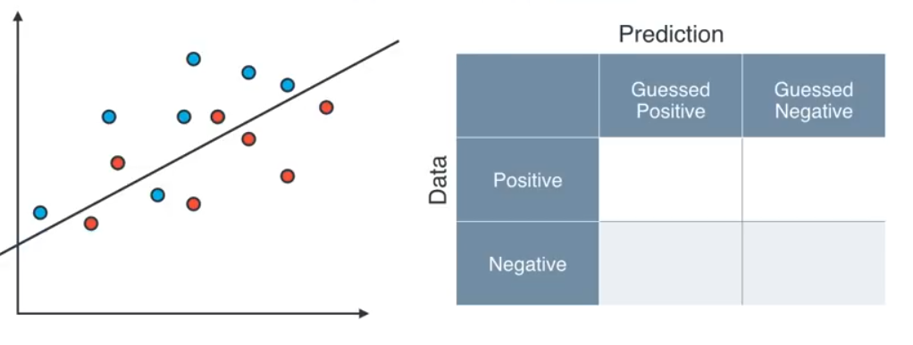
Confusion matrix
Fill the matrix

Slide 22
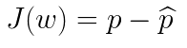
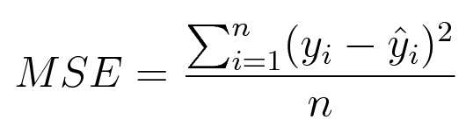
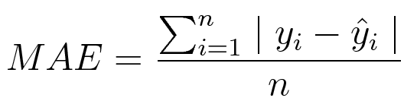
What is a loss function
Any machine learning algorithm leans by using a loss function J(.)
This function evaluates how the prediction deviates from the actual output
Different loss function gives different error for the same prediction
There are various loss functions to choose from depending on
Type of ML algorithm
Ease of derivative calculation
outliers presence in input data
Broadly there are two types of loss function
Regression and Classification
Regression loss function
Mean square / L2 loss
Mean absolute error / L1 loss

Slide 23
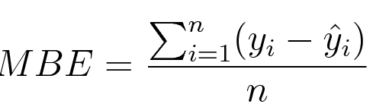
Contd..
MSE is a nice function to calculate gradient
Outliers are heavily penalized in MSE , thus becomes very sensitive
MAE needs more complicated solution like linear programming to calculate gradient
Also it is more robust to outliers
Mean Biased error
Like MAE, without the absolute function
Positive and negative errors cancel each other
It is useful to determine if the model has positive or negative bias

Slide 24
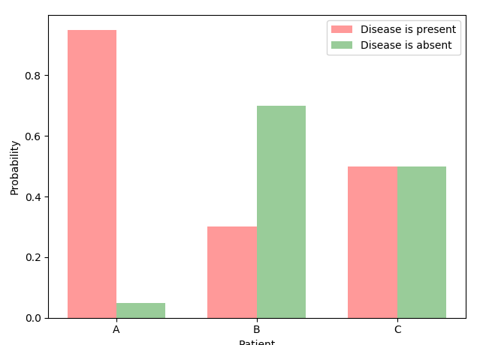
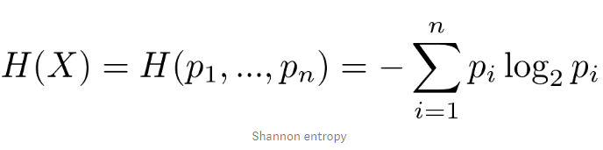
What is entropy
Which patient has most uncertainty?
Given certain assumption entropy is the measure of this uncertainty
for an event X with n possible outcomes and probabilities p_1, …, p_n: shanon entropy is calculated as

Slide 25
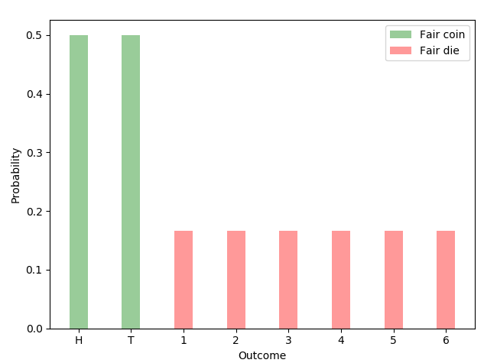
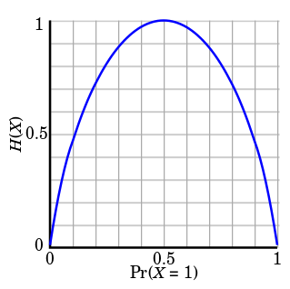
Contd..
Property 1: Uniform distributions have maximum uncertainty
Given n possible outcomes, maximum entropy is maximized by equiprobable outcomes: for Bernoulli trials (events with two possible outcomes and probabilities p and 1-p):

Slide 26
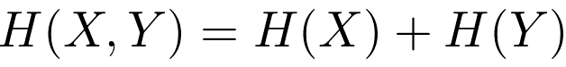
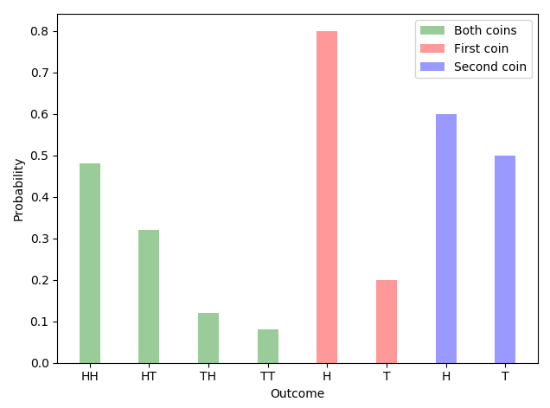
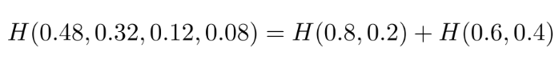
Contd..
Property 2: Uncertainty is additive for independent events
Lets consider two particular coins. The first coin lands heads (H) up with an 80% probability and tails (T) up with a probability of 20%.

Slide 27
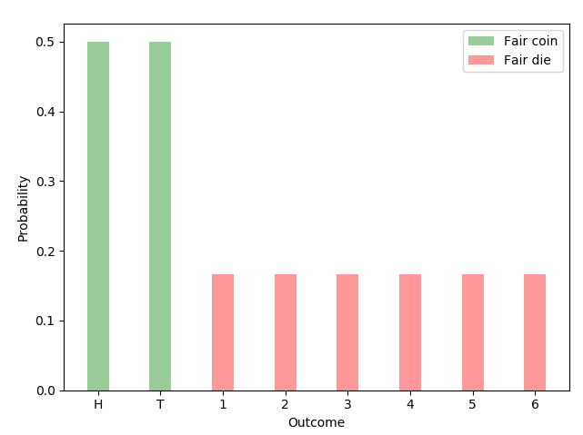
Contd..
Property 3: Uniform distributions with more outcomes have more uncertainty
let’s say you win if the coin lands heads up or the die lands on face 1. Which one you will choose?
A if you are a profit maximizer and B if you prefer with more variety and uncertainty.
H(1/6, 1/6, 1/6, 1/6, 1/6, 1/6) > H(0.5, 0.5).

Slide 28
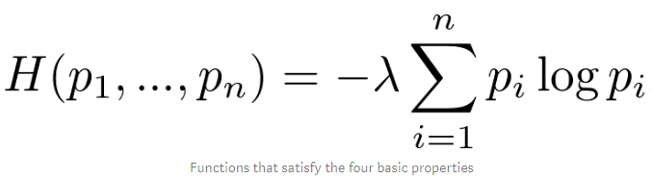
Contd..
Uniqueness theorem : Only family of functions satisfying tall the basic properties is of the form
Setting λ = 1 and using the binary logarithm gives us the Shannon entropy

Slide 29
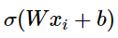
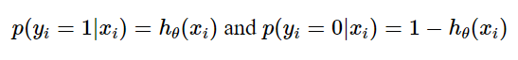
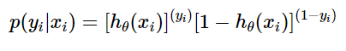
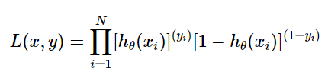
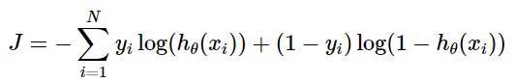
Cross entropy
Given a binary classification problem the prediction based on our linear model after the activation is
This produces a value between 0 and 1
How can we convert this value into a probability? Use the same?
Two probabilities : +ve and –ve can be formulated as
Combining these we get
Likelihood
Loss function

Slide 30
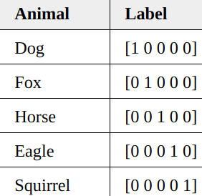
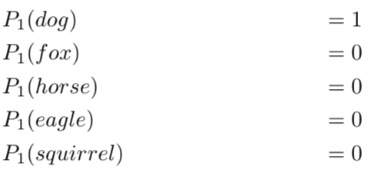
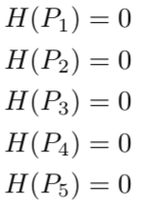
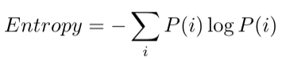
Cross entropy in learning
Let us assume we have a dataset of images corresponding to animals
Using one hot encoding we can represent as
If we treat this as a probability distribution of each image then
For dog
The entropy for each image

Slide 31
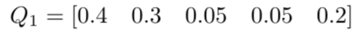
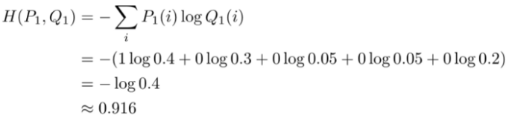
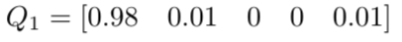
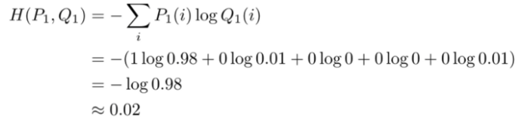
Contd..
In real life we might get a classifier output as
In this case we can calculate the cross entropy
This is a higher entropy than 0, but does not make much sense
Lets say on further training the classifier output becomes
Now the cross entropy becomes
So as model gets better trained cross entropy gets closer to zero
This is why cross entropy is used as a loss function for classification model

Slide 32
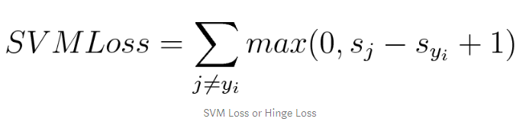
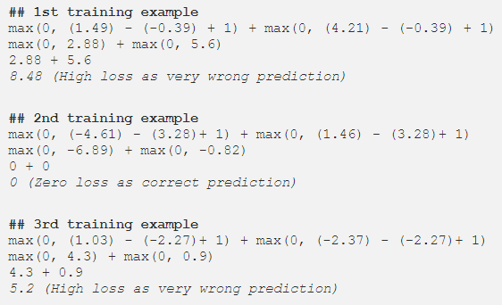
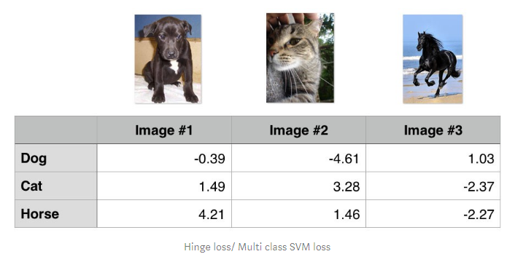
Classification Loss function
Hinge Loss / Multi class SVM loss
Used for maximum margin classification
Mostly used in SVM
Though it is not a differentiable function, however it’s a convex function
Hence easy to use with usual convex optimizer algorithm

Slide 33
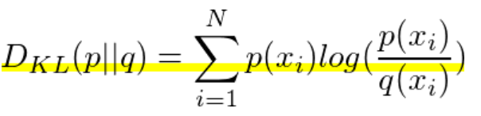
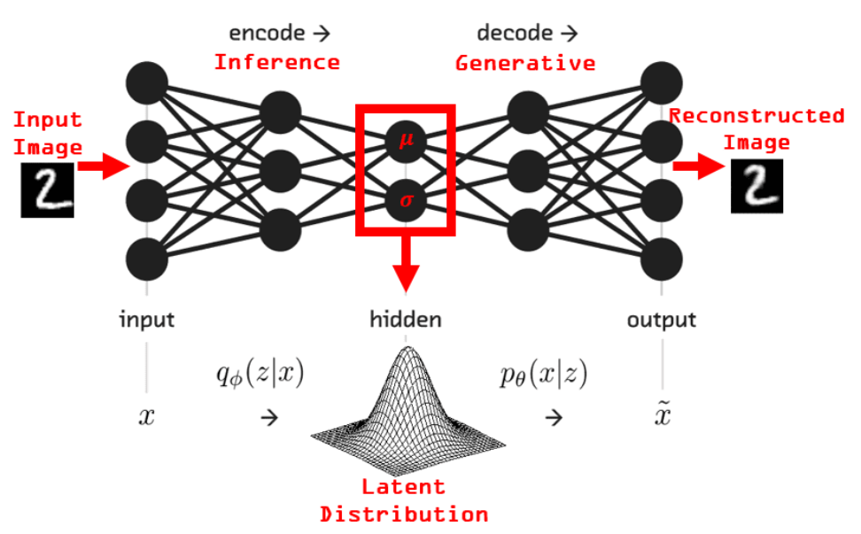
KL divergence
KL divergence is a relative entropy measure
It is the difference between two distributions
The lower the value, the better is the model closeness to reality
When this divergence is considered in the context of Bayesian – q is the prior probability, and p is the posterior probability
The difference would be the direct indication of the amount of information gain across the process
One direct application of KL divergence is variational autoencoder

Slide 34
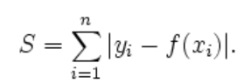
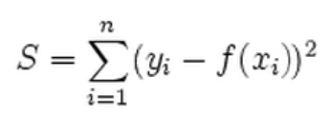
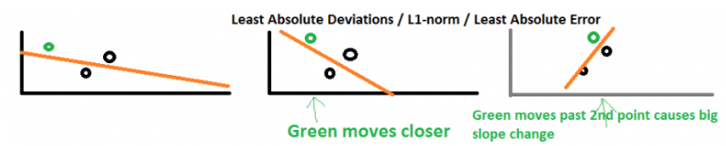
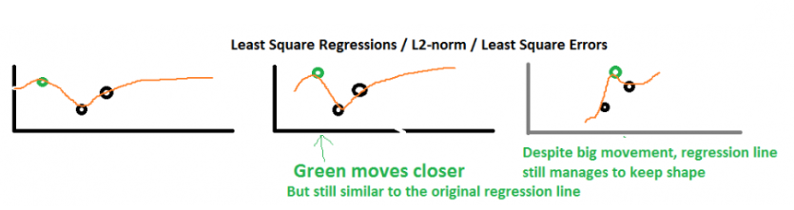

Difference between L1 and L2 norm
L1 norm | L2 norm
Non robust, Unique solution, stable, non sparse, computationally efficient | Robust, non-unique, non stable, sparse, computationally inefficient
L2 norm = Green line | L1 norm = red, yellow , blue

Slide 35


Precision & Recall

Slide 36



Precision and Recall
30 predictions made – those to the right are labelled as spam
What happens if we increase / decrease the threshold ? Lets work out
This is also known as tug of war – between precision and recall

Slide 37

F1 score
It is also known as balanced F score
It is interpreted as a weighted average of precision and recall
Best F1 score at 1 and worst 0
Output for the following?

Slide 38

ROC curve
Receiver operating characteristic curve
Graph shows the performance of a classification model at all classification thresholds
Curve plots two parameters – TP, FP
TPR = Recall = TP / (TP + FN)
FPR = FP / (FP + TN)

Slide 39


AUC curve
Area under the ROC curve
It measures the entire two-dimensional area underneath the entire ROC curve
It represents the probability that a random example is positioned to the right of a random negative example

Slide 40


Bias variance dilemma
Bias
Difference between the average prediction and the target
It gives more attention to model simplification rather training data
Variance
Variability of the model prediction
Pays lot of attention to training data and less attention to model
Lets consider a linear prediction model Y = f(X) + e
The square error function is

Slide 41

Bias/Variance through bulls eye diagram

Slide 42

Contd..

Slide 43



Gradient
Analog of ordinary derivative for function of several variables
Slope (tangent) of the graphs of the function
If f(x1,x2,…,xn) is differentiable scalar field (function)
Gradient is the vector of the n partial derivatives of f
1 X n matrix of linear map
Points in the direction of the greatest increase of this function
Length of this vector indicates rate of increase
In the 3D cartesian system –

Slide 44



Jacobian Matrix
It is a matrix of all first order partial derivatives of a vector value function
m X n matrix of linear map
Jacobian matrix determinant can be used for change of variable
To learn a function f from n data points with p parameters, we can rather learn the vector valued function using Jacobian

Slide 45



Gradient Descent
When optimizing a smooth function, we make a small step in the gradient
For a step size small enough gradient descent makes monotonic improvement at every iteration
Speed is however an issue

Slide 46



Gradient descent with momentum
Consider the contours of a loss function as below
With each iteration we might encounter different magnitude of vertical and horizontal oscillation
This vertical oscillation might slow down the convergence
As the vertical oscillations are both + and -, we can take the exponential average of dW and dB that will cancel out

Slide 47


Implement momentum
First calculate the exponentially weighted average
Beta is the momentum
Now the parameters can be updates as

Slide 48





Hessian Matrix
Matrix with second order partial derivatives
is the rate of change in direction x2 of the gradient in direction x1
Assume a 2 dimensional quadratic equation to be minimized
Its gradient is Ax- b and Hessian is A. Optimal soln Ax- b = 0 ;
Consider the eigenvector decomposition of H
Each eigenvector represents a direction where the curvature is independent of other direction
The curvature in the direction of the eigenvector is determined by eigenvalue
The larger the eigenvalue faster is the convergence in the direction of eigenvector

Slide 49

Hessian Matrix – Putting it all together
The step size is bounded by the largest eigenvalue
The speed of the convergence is determined by the smallest eigenvalue
The ratio between the largest and smallest eigenvalues is called condition number
If the condition number is very large then it becomes a ill conditioned problem
When we look into small local areas of the loss function we can approximate as a quadratic form using Taylor expansion
To solve this ill conditioning problem
Normalize inputs
Add momentum
Reduce step size in direction of larger curvature
Increase step size in direction of smaller curvature

Slide 50




Activation function - Sigmoid
Smooth function - Derivative calculation easy
Derivative quashes – Vanishing gradient

Slide 51




Logistic function

Slide 52

Softmax
This is an activation function that turns scores into probabilities
Output is small if the score is small and vice versa however the proportion is not uniform
It uses an exponential function
Cross entropy is mostly used as loss function

Slide 53

Vanishing gradient problem
Looking at the graph above, you can see that the derivative function is zero for a large number of input values
For mod X (X = input) > 0 , the derivative becomes closer to zero
For shallow network this is not a problem
For deep network with many layers, gradient starts becoming too small as we back propagate
Training paralysis happens

Slide 54

ReLU activation function
Y = max(0,x)
Cheap computation
Converges faster – no vanishing gradient problem
It is sparsely activated
Model sparsity allows different neurons to perform different roles
Not everyone fires at the same time

Slide 55
Bias variance dilemma

Slide 56



2011 Fukushima Nuclear disaster

Slide 57



Underfitting
Generalize model: All swans are white
Zero variance in observed data
The model is too simple for the actual data
ML modelling objective
Generalization (bias/variance balance)
An induction process from sample training data towards generalization

Slide 58

Regularization
Consider the loss for both training and validation set
When we minimize the loss empirically minimize(Loss(Data|Model))
This optimization goal can lead to overfitting
Rather we add a regularization term
Minimize(Loss(Data|Model) + complexity(model))
This is called structural risk minimization
Model complexity can be defined as a function of the feature weights

Slide 59
Contd..
A feature weight with a high absolute value is more complex than a feature with less absolute value
In L2 regularization sum of squares of all feature weights are used
Weights close to 0 have low impact on model complexty
Outliers weights can have a huge impact
Consider the following weights
Calculate the L2 regularization term
Comment on which feature adds the most complexity
How it affects the model
Push weight value to 0
Push mean of weights to 0 with a normal curve

Slide 60


Regularization rate
Usually a regularization rate is used for the regularization term
Histogram of weight distribution high vs low lambda value

Slide 61
Density estimation
Estimating the probability distribution for a sample of observations
One most important method used in machine learning is maximum likelihood estimation
MLE – define a likelihood function for calculating the conditional probability
This approach can be used to search a space of possible distributions and parameters
This flexible framework provides foundations for methods like linear regression and logistic regressions
In summary it is an optimization method that results in the best fit for the joint probability of the data samples
Conditional probability -> P(x1,x2, x3,…,xn;theta)
Also known as likelihood function L(X ; theta)
Objective is maximize L(X ; theta)

Slide 62


Slide 63



Maximum Likelihood Estimation (MLE)
Method for estimating some variable for probability distribution or graphical models
Real life e.g. calculating sample mean and variance for Gaussian fit
Lets say we have a likelihood function
MLE for
Asymptote for above is 0, as numbers less than 1
So we take a monotonic increasing log function
Taking the derivative and equating to 0, we can solve the parameter

Slide 64




MLE Exercise
Assume 3 data points 8, 8.5 and 9. And assume they are from Gaussian process. What will be maximum likelihood estimates of the Gaussian distribution
The joint pdf of observing the three data points (Joint likelihood = product of all likelihood)

Slide 65
MLE
The likelihood function seen so far is differentiable – first derivative
vanishes at max/min point
Additional condition is the function is max that is log likelihood
function is convex in the neighborhood
All Second partial derivative of the log likelihood are negative
Determinant of the Hessian matrix is negative definite
When model involves many parameters and/or pdf is highly non linear
analytic solution is not possible
We need numerical solution – non linear optimization problem

Slide 66
Ensemble method
It’s a technique that combines several models in order to produce one optimal model
The main hypothesis is that when several weak learners are trained to solve the same problem together they can get a better result
Useful for classification or regression
For classification aggregate prediction by voting
For regression aggregate prediction by averaging
Two types
Heterogeneous – ANN + SVM
Homogeneous –
ensemble of 100 decision trees
Individual models are referred as base classifier
Most common classification type
Bagging
Boosting
stacking

Slide 67
Contd..
Bagging
Mostly consider homogeneous weak learners (base)
Learners are trained independently
Deterministic averaging process used for combination
Boosting
Mostly consider homogeneous weak learners (base)
Learners are trained sequentially
Each learner is rained based on the previous learners output
Deterministic strategy is used for combination
Stacking
Often consider heterogeneous weak learners
Learners is trained in parallel
Combination is done by training a meta model

